Slide 1
SA 2.0 / Curiosity
February 24th 2015

Slide 2
SA 2.0 / Curiosity PI1
Release train and teams established
Continous delivery adopted
Curiosity platform established
Enabling Domino / HP Storage
Roadmap and technical strategy
analytics, environment monitoring, cloud, SA10, UX/UI
Internal release with PI2 in June 2015

Slide 3



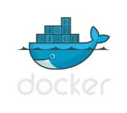

Current CI Environment
CSM Cloud VM’s
Jenkins Master
Jenkins Slave
Jenkins Slave
Jenkins Slave
Registry
Images
FUT
DEV
ITG
Docker Cluster
G
i
t
H
u
b
F
l
o
w
GVC Cloud
GitHub
Enterprise
Web Hook

Slide 4


Jenkins CI Architecture Overview
Docker Images
docker pull
Ansible (Chef)
Automated installation, configuration and administration of Docker hosts and Shipyard
CI Docker Cluster
docker push
Shipyard
Docker Cluster
management
and container deployment/deletion, ensuring scalable Jenkins CI Cluster
Jenkins Master
Jenkins Slave
Jenkins Slave
Jenkins Slave
Docker
Registry
Docker Images
Registry
Updated Jenkins images pushed to Registry
Pulled down from VM’s
Run images through Shipyard or command line
Rapid deployment of new Jenkins slaves, ensuring scalability
Docker Host | Description
C0052445.itcs.hp.com | Shipyard
C0051928.itcs.hp.com | Interlock
C0052446.itcs.hp.com | Jenkins Master
C0052447.itcs.hp.com | Registry
C0052448.itcs.hp.com | Logstash
C0052449.itcs.hp.com | Jenkins Slave
C0052450.itcs.hp.com | Jenkins Slave
C0052451.itcs.hp.com | Jenkins Slave

Slide 5
SA2.0 Current GitHub Process Flow
DEV Branch
DEV Branch
DEV Branch
DEV Branch
Push
Push
Push
Push
Fix
Fix
Fix
Fix
Build
Build
Build
Build
CI
CI
CI
CI
Pull Request
Pull Request
Pull Request
Pull Request
Code/Peer Review
MASTER Branch

Slide 6
Curiosity Application Landscape
Apache
Revese Proxy
Apache
Reverse Proxy
Tomcat
REST APIs
Tomcat
Portal UIs
Tomcat
REST APIs
Tomcat
Portal UIs
Tomcat
REST APIs
Tomcat
Portal UIs
Kafka
Kafka
Kafka
Hadoop
HBase/ Storm / Zookeeper
Vertica
IT Private Cloud
BDS IT

Slide 7
SA 2.0 PRO Landscape
Houston 4
Houston West →

Slide 8
SA1.0 Reporting/Analytic Data Flow

Slide 9
SA 2.0 Reporting/Analytic Data Flow

Slide 10
SA 2.0 End-to-End Analytics

Slide 11
Goals of PI2 (draft)
March / April / May
ITG Environment ready; Stretch goal Production (must be ready by July)
SA 2.0 production performance ready to accept 3PAR telemetry from RDA Domino for HPSD July early adopter program
IPv6
Onboard select connected products to SA 2.0
Thing definition
Thingformation definition
Parsers
Analytics and Quality data
Hardware platform determined and setup
Prototype for quality reporting (replacement for SEQUAL)
Initial UX with user role definition and entitlement/ICM handling
Landing page with environment landscape
Platform search
Stretch goals: Knowledge search; New User registration
Migration roadmap

Slide 12
Backup

Slide 13
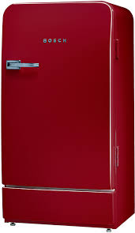
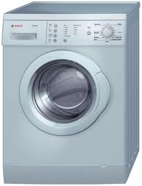

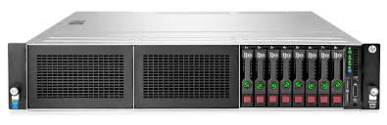
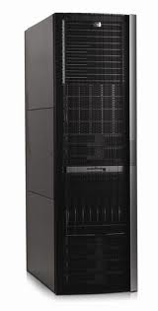
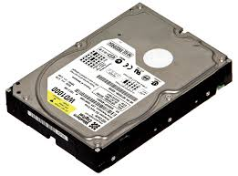
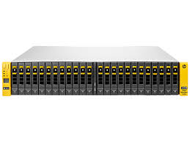

Things
Proliant dl 380
Rack Server
3Par 7450
Thing is a representation of an existing physical or virtual object
An instance of a ThingType, storing the real values for Attributes, Relations as determined by handlers.
Things

Slide 14
Thingformations
Proliant dl 380
Rack Server
Configuration
collection
Remaining
washing
time
Reboot
Temperature
Power
Failure
Event
3Par 7450
Entitlement
Data about one of more Things at a specific point in time.
It can contain status, details, configuration, Relations, basically Attributes which describe the corresponding Thing instances
Patch
level
Thingformations

Slide 15
Relationships
Proliant dl 380
Rack Server
3Par 7450
Relationships

Slide 16
Concepts & Terms
User Human User of the system identified by a unique identifier provided by an authentication system. For SA 2.0 this will be achieved by integration with HPP / atHP single sign on capabilities.
Domain Isolated tenant / part (data and access isolation) of the platform with separate object definitions.
e.g. SA 2.0, Boeing, BMW
Group Account Group, Company or Organization associated with the user.
Typically the first user creates the initial group Account which then can be associated with further users.
All Communication Channels and Things are associated with the Customer. Maybe better name: account, collection, constellation
CommunicationChannel The Communication Channel is registered by the User with a corresponding security level. A client can use the Communication channel to submit data, register things … in place of the user.
As the communication channel is associated with a customer the data objects submitted through this channel get automatically associated with that customer instance as well.
NOTE: Can be viewed also a security context or an API Key

Slide 17
Migration
Epics / Features
Tee SA 1.0 data to SA 2.0
SADB migration
Insight Online and SA2.0
IRS and native SA2.0 client
Migrate installed base clients to SA 2.0
RSDC migration (incl. BLI, JRules, GDID)
SA 1.0 client obsolescence (IRS 5.x, IRS 7.x, Direct Connect 1.0)
Notes:
Note: is there a Portal 2.0 beta in parallel with “Retire SADB” feature?
Priorities of features. Is Insight Online prioritized correctly? I have it 3rd because I don’t think a replacement can be delivered in PI 2.
When is event processing introduced to SA2.0?
Need to validate the UX for native client. Phased approach for client – e.g. Fusion/RSPI migrates first? Or migrate to SA2.0 API first, then change UX later.
Concern that SADB retirement is more complex than realized; need additional spikes to raise confidence. Or a contingency plan.

Slide 18

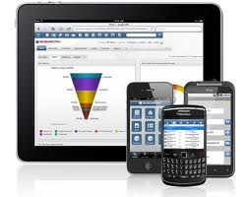

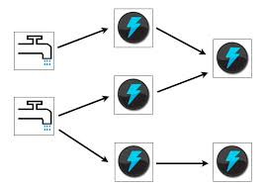




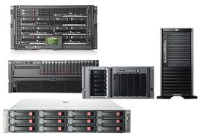





The Curiosity Architecture Component Stack
analyze
Selected technologies
Things Instances
Data Processing & Transformation
Search
Portal
Mobile
Curiosity APIs
Kafka
STORM
Analytics &
Reporting
Analytic
UI/API
Data Analysts
Business Units
Action & Notify
Kafka
Thing Definitions
aggregate
Things
Control
Apps
augment
Onboarding UI/API
On Boarding
access
Security
Logging & Monitoring
Infrastructure
Data Lake
Clouds
register
Monitoring & Mgmt. UI/API
Operation
Support
Platform users
Curiosity platform
Platform clients

